Slide 1
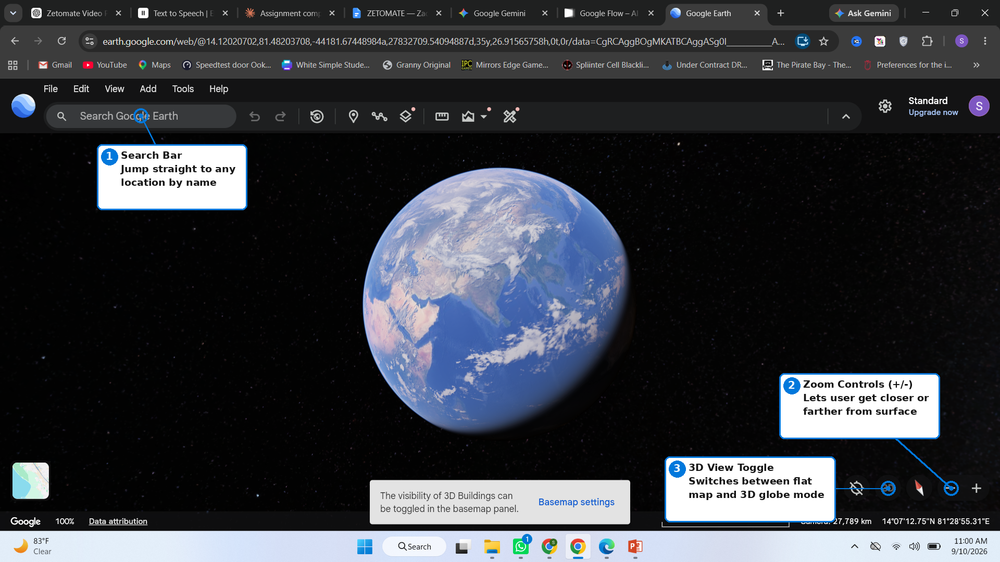
HCI Focus — Google Earth
Human-Computer Interaction: how the interface lets the user control and navigate the 3D space
1 Search Bar
Lets the user jump straight to any place on Earth by typing its name, instead of manually scrolling and zooming.
2 Zoom Controls (+ / -)
Give direct, incremental control over how close the camera sits to the surface — a clear, always-visible affordance.
3 3D View Toggle
Switches between a flat 2D map and the full 3D globe, letting the user choose the interaction mode that fits their task.

Slide 2
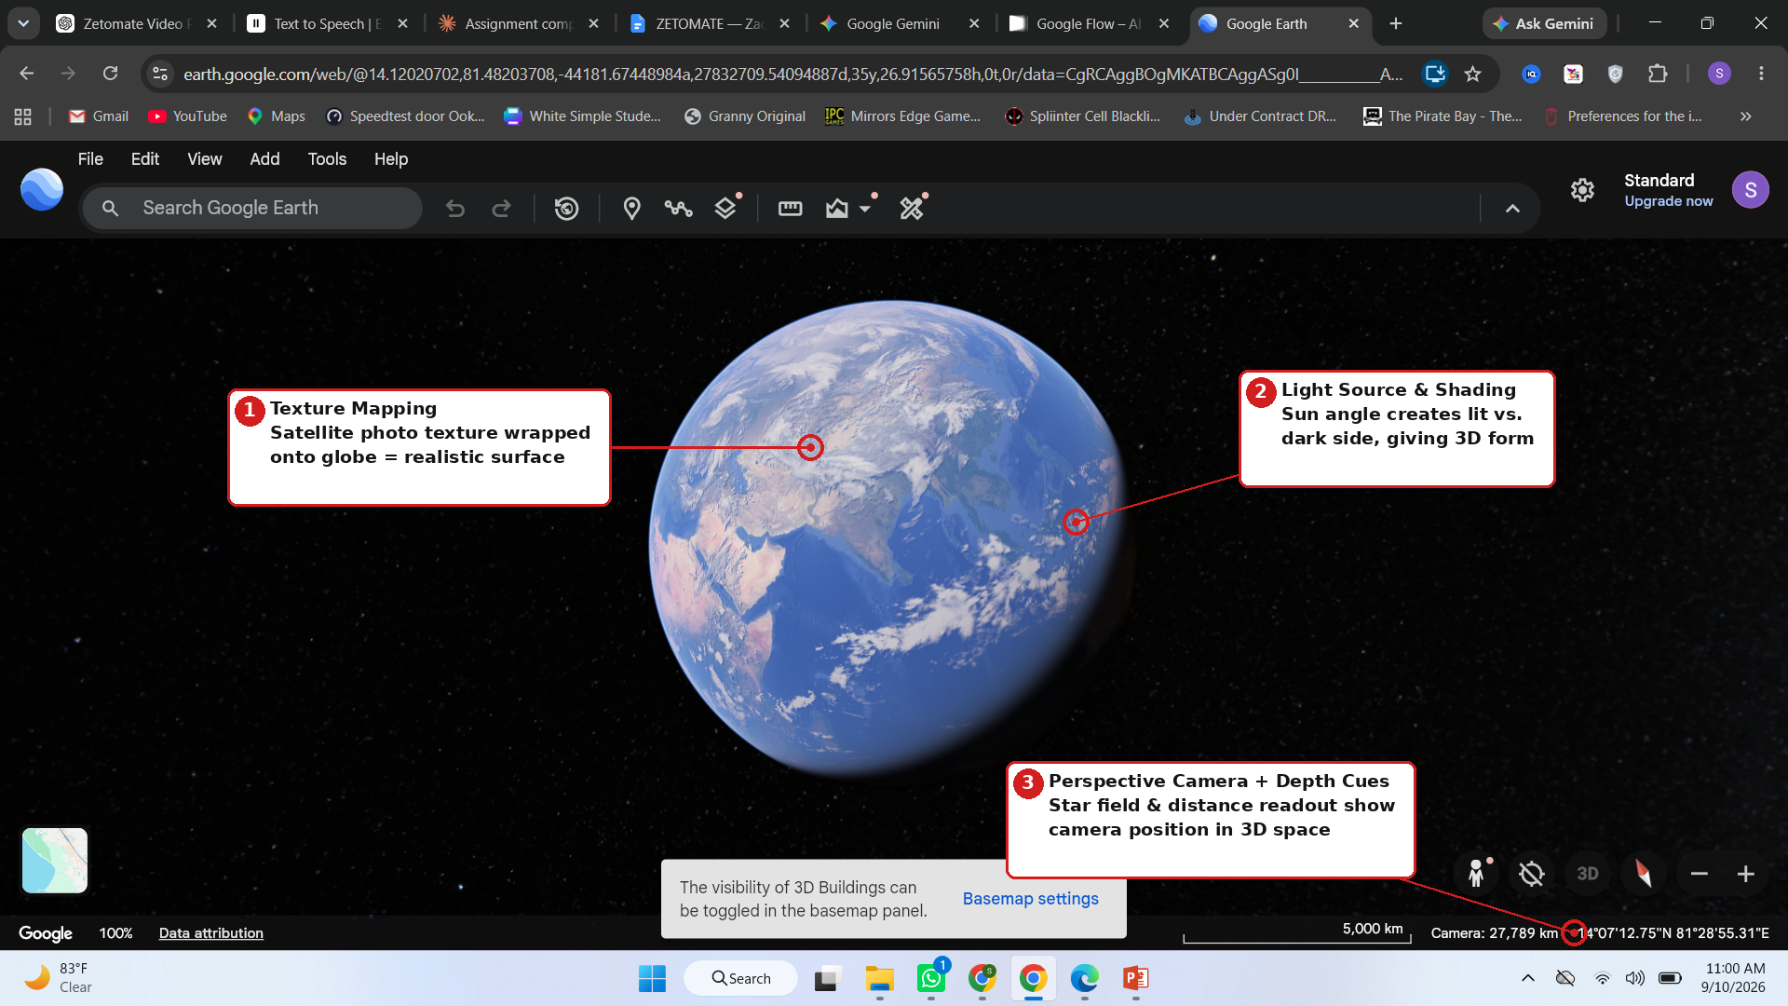
CG Focus — Google Earth
Computer Graphics: how rendering techniques build the illusion of a real 3D planet
1 Texture Mapping
Real satellite-photo textures are wrapped onto the globe's mesh, giving continents, oceans and clouds a photorealistic look.
2 Light Source & Shading
A simulated sun angle lights one side of the globe while the other falls into shadow, giving the flat image a sense of solid, rounded form.
3 Perspective Camera & Depth Cues
The star field, curvature of the sphere, and live camera-distance readout all reinforce that the viewer is floating in 3D space, not looking at a flat map.

Slide 3
Reflection
1. How does Computer Graphics quality help or hinder interaction?
Google Earth's realistic lighting and photo-texture rendering make the experience more immersive and help users judge terrain, scale and location intuitively at a glance. However, this same realism can hinder interaction on slower devices or connections — heavy 3D rendering causes lag when rotating or zooming, which can make simple navigation feel sluggish and frustrating.
2. One simple HCI change to improve the interface
Add a small, permanent on-screen label under the zoom and 3D-toggle icons (instead of icon-only buttons). Many controls currently rely on the user hovering to guess their function; short text labels would reduce the learning curve for new users and make the toolbar's purpose clear immediately.
App used: Google Earth (Web) — interactive 3D globe visualization tool

